Slide 1
Diarrheagenic E. coli Discussion
GROUPS, MECHANISMS OF PATHOGENICITY, CLINICAL SYNDROMES, AND o:h SEROTYPES

Slide 2
Escherichia coli
Is the predominant facultative anaerobe of the human colonic flora.
The organism typically colonizes the infant gastrointestinal tract within hours of life, and, thereafter, E. coli and the host derive mutual benefit.
E. coli usually remains harmlessly confined to the intestinal lumen; however, in the debilitated or immunosuppressed host.
Three general clinical syndromes result from infection with pathogenic E.coli strains: urinary tract infection, meningitis, and diarrheal disease.

Slide 3
The diarrheagenic E. coli strains
enterotoxigenic e. coli (ETEC)
enteropathogenic E. coli (EPEC)
enterohemorrhagic E. coli (EHEC)
enteroaggregative E. coli (EAEC)
enteroinvasive e. coli (EIEC)

Slide 4

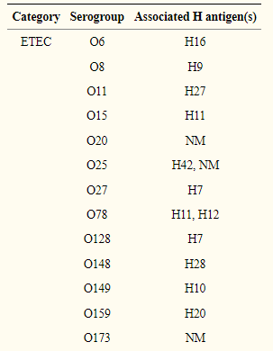
enterotoxigenic e. coli (ETEC)
Serotypes:
Virulence factors: Heat-stable and heat-labile enterotoxins as well as Colonization Factor Antigen I (CFA/I).
Pathogenicity: the organisms colonize the surface of the small bowel mucosa and elaborate their enterotoxins, giving rise to a net secretory state. Some investigators have reported that ETEC strains may exhibit limited invasiveness in cell cultures, but this has not been demonstrated in vivo
Clinical Syndromes: The illness is typically abrupt in onset with a short incubation period (14 to 50 h). The diarrhea is watery, usually without blood, mucus, or pus; fever and vomiting are present in a minority of patients. ETEC diarrhea may be mild, brief, and self-limiting or may result in severe purging similar to that seen in V. cholerae infection
Serotypes:
Notes:
Virulence factors Ref: Crofts, A. A., Giovanetti, S. M., Rubin, E. J., Poly, F. M., Gutiérrez, R. L., Talaat, K. R., … Trent, M. S. (2018). EnterotoxigenicE. colivirulence gene regulation in human infections. Proceedings of the National Academy of Sciences, 201808982. doi:10.1073/pnas.1808982115

Slide 5
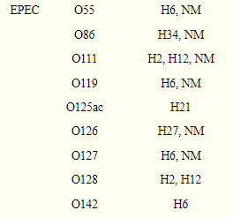
enteropathogenic E. coli (EPEC)
Virulence factors: The bundle-forming pilus (BFP) as well as type III secreted proteins EspA and EspB.
Pathogenicity: The hallmark of infections due to EPEC is the attaching-and-effacing (A/E) histopathology. This striking phenotype is characterized by effacement of microvilli and intimate adherence between the bacterium and the epithelial cell membrane. Marked cytoskeletal changes, including accumulation of polymerized actin, are seen directly beneath the adherent bacteria; the bacteria sometimes sit upon a pedestal-like structure.
Clinical Syndromes: causes primarily acute diarrhea, the duration of hospitalization ranged from 21 to 120 days. The infection can often be quite severe, and many clinical reports emphasize the severity of the disease. In outbreaks in the United States and the United Kingdom in the mid-20th century, mortality rates of 25 to 50% were reported
Serotypes:
Notes:
Virulence factor Ref:
Khursigara, C., Abul-Milh, M., Lau, B., Girón, J. A., Lingwood, C. A., & Barnett Foster, D. E. (2001). Enteropathogenic Escherichia coli virulence factor bundle-forming pilus has a binding specificity for phosphatidylethanolamine. Infection and immunity, 69(11), 6573–6579. https://doi.org/10.1128/IAI.69.11.6573-6579.2001.
Abe, A., Heczko, U., Hegele, R. G., & Brett Finlay, B. (1998). Two EnteropathogenicEscherichia coliType III Secreted Proteins, EspA and EspB, Are Virulence Factors. The Journal of Experimental Medicine, 188(10), 1907–1916. doi:10.1084/jem.188.10.1907

Slide 6
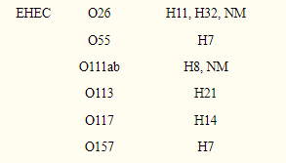
enterohemorrhagic E. coli (EHEC)
Virulence factors: The Shiga toxins
Pathogenicity: Most of the work on pathogenic factors of EHEC has focused on the Stx genes, which are encoded on a bacteriophage inserted into the chromosome.
Clinical Syndromes: non-bloody diarrhea, hemorrhagic, and hemolytic uremic syndrome are the most common clinical syndromes, complications that can arise include cholecystitis, colonic perforation, intussusception, pancreatitis, post-hemolytic biliary lithiasis, post-infection colonic stricture, rectal prolapse, appendicitis, hepatitis, hemorrhagic cystitis, pulmonary edema, myocardial dysfunction, and neurological abnormalities
Serotypes:
Notes:
Virulence factors Ref: Karch H. (2001). The role of virulence factors in enterohemorrhagic Escherichia coli (EHEC)--associated hemolytic-uremic syndrome. Seminars in thrombosis and hemostasis, 27(3), 207–213. https://doi.org/10.1055/s-2001-15250

Slide 7
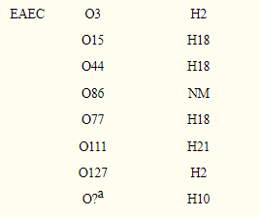
enteroaggregative E. coli (EAEC)
Virulence factors: The aggregative adherence fimbria (AAF) variant; AggR (a global regulator of EAEC virulence); dispersin, required for proper dispersal of AAFs on the bacterial surface; and the Aat transporter system.
Pathogenicity: EAEC strains characteristically enhance mucus secretion from the mucosa, with trapping of the bacteria in a bacterium-mucus biofilm. EAEC infection is accompanied by cytotoxic effects on the intestinal mucosa.
Clinical Syndromes: watery, mucoid, secretory diarrheal illness with low-grade fever and little to no vomiting. Studies in India also suggest that the illness is most likely be manifested by watery, secretory diarrhea in the absence of fever and without gross blood.
Serotypes:
Notes:
Virulence factor ref: Boll, E. J., Struve, C., Boisen, N., Olesen, B., Stahlhut, S. G., & Krogfelt, K. A. (2013). Role of enteroaggregative Escherichia coli virulence factors in uropathogenesis. Infection and immunity, 81(4), 1164–1171. https://doi.org/10.1128/IAI.01376-12

Slide 8
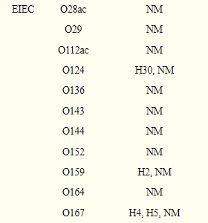
enteroinvasive e. coli (EIEC)
Virulence factors: Shigella enterotoxin and type III secretion system.
Pathogenicity: The precise pathogenic template for EIEC has yet to be developed. However, studies suggest that its pathogenic features are the same as Shigella spp. Both organisms have been shown to invade the colonic epithelium, a phenotype mediated by both plasmid and chromosomal loci.
Clinical Syndromes: watery diarrhea, which can be indistinguishable from the secretory diarrhea seen with ETEC. Only a minority of patients experience the dysentery syndrome, manifested as blood, mucus, and leukocytes in the stool; tenesmus; and fever.
Serotypes:
Notes:
Virulence factor ref: Gauthier, A., Robertson, M. L., Lowden, M., Ibarra, J. A., Puente, J. L., & Finlay, B. B. (2005). Transcriptional inhibitor of virulence factors in enteropathogenic Escherichia coli. Antimicrobial agents and chemotherapy, 49(10), 4101–4109. https://doi.org/10.1128/AAC.49.10.4101-4109.2005

Slide 9
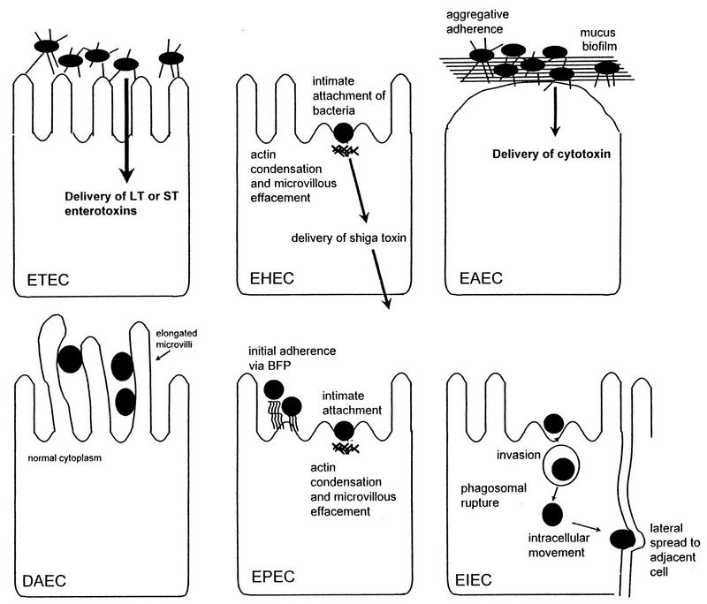
Pathogenic schemes of diarrheagenic E. coli.

Slide 10
References
Drasar B S, Hill M J. Human intestinal flora. London, United Kingdom: Academic Press, Ltd.; 1974. pp. 36–43. https://scholar.google.com/scholar_lookup?title=Human+intestinal+flora&author=B+S+Drasar&author=M+J+Hill&publication_year=1974&
Pathogenesis of Escherichia coli diarrhea.DuPont HL, Formal SB, Hornick RB, Snyder MJ, Libonati JP, Sheahan DG, LaBrec EH, Kalas JP N Engl J Med. 1971 Jul 1; 285(1):1-9. https://www.ncbi.nlm.nih.gov/pmc/articles/PMC121379/#B175
Molecular cloning of epithelial cell invasion determinants from enterotoxigenic Escherichia coli.Elsinghorst EA, Kopecko DJ nfect Immun. 1992 Jun; 60(6):2409-17. https://www.ncbi.nlm.nih.gov/pubmed/1587608/
Escherichia coli O114:nonmotile as a pathogen in an outbreak of severe diarrhea associated with a day care center.Bower JR, Congeni BL, Cleary TG, Stone RT, Wanger A, Murray BE, Mathewson JJ, Pickering LK J Infect Dis. 1989 Aug; 160(2):243-7. https://www.ncbi.nlm.nih.gov/pubmed/2668422/
Attaching and effacing activities of rabbit and human enteropathogenic Escherichia coli in pig and rabbit intestines.Moon HW, Whipp SC, Argenzio RA, Levine MM, Giannella RA Infect Immun. 1983 Sep; 41(3):1340-51. https://www.ncbi.nlm.nih.gov/pubmed/341657/
261. Griffin P M. Escherichia coli O157:H7 and other enterohemorrhagic Escherichia coli. In: Blaser M J, Smith P D, Ravdin J I, Greenberg H B, Guerrant R L, editors. Infections of the gastrointestinal tract. New York, N.Y: Raven Press; 1995. pp. 739– https://scholar.google.com/scholar_lookup?title=Infections+of+the+gastrointestinal+tract.&author=P+M+Griffin&publication_year=1995&
Characterization of enteroadherent-aggregative Escherichia coli, a putative agent of diarrheal disease.Vial PA, Robins-Browne R, Lior H, Prado V, Kaper JB, Nataro JP, Maneval D, Elsayed A, Levine MM J Infect Dis. 1988 Jul; 158(1):70-9. https://www.ncbi.nlm.nih.gov/pubmed/2899125/
Enteroaggregative Escherichia coli associated with persistent diarrhea in a cohort of rural children in India.Bhan MK, Raj P, Levine MM, Kaper JB, Bhandari N, Srivastava R, Kumar R, Sazawal S J Infect Dis. 1989 Jun; 159(6):1061-4. https://www.ncbi.nlm.nih.gov/pubmed/2656875/
Shigella subversion of the cellular cytoskeleton: a strategy for epithelial colonization.Goldberg MB, Sansonetti PJ Infect Immun. 1993 Dec; 61(12):4941-6. https://www.ncbi.nlm.nih.gov/pubmed/8225568/
413. Marier R, Wells J G, Swanson R C, Dallhan W, Mehlman I J. An outbreak of enteropathogenic Escherichia coli foodborne disease traced to imported french cheese. Lancet. 1973;ii:1376–1378. https://www.ncbi.nlm.nih.gov/pubmed/6370005/
Nataro JP, Kaper JB. Diarrheagenic Escherichia coli [published correction appears in Clin Microbiol Rev 1998 Apr;11(2):403]. Clin Microbiol Rev. 1998;11(1):142-201. doi:10.1128/CMR.11.1.142 https://www.ncbi.nlm.nih.gov/pmc/articles/PMC121379/
Duan, Q., Yao, F. & Zhu, G. Major virulence factors of enterotoxigenic Escherichia coli in pigs. Ann Microbiol 62, 7–14 (2012). https://doi.org/10.1007/s13213-011-0279-5

